Slide 1
Thinkpad 701C x Framework Mechanical Guide
Karl Buchka 2/19/2024

Slide 2
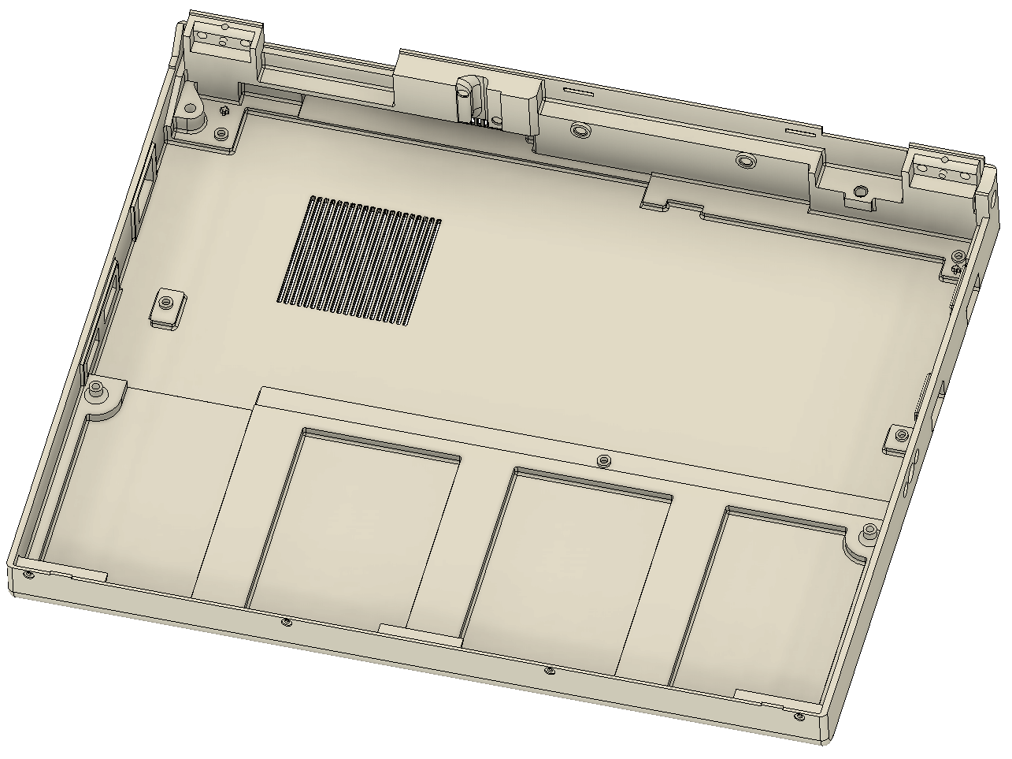
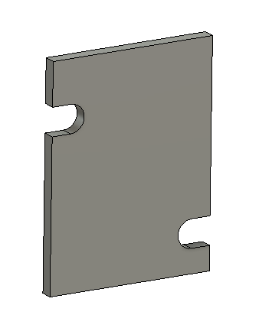
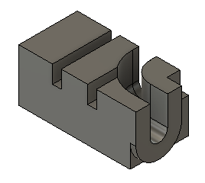
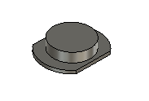
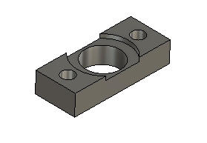
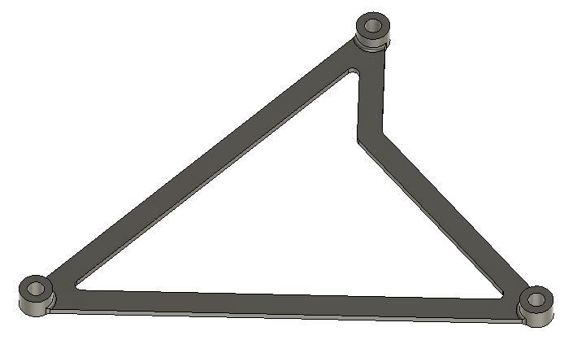
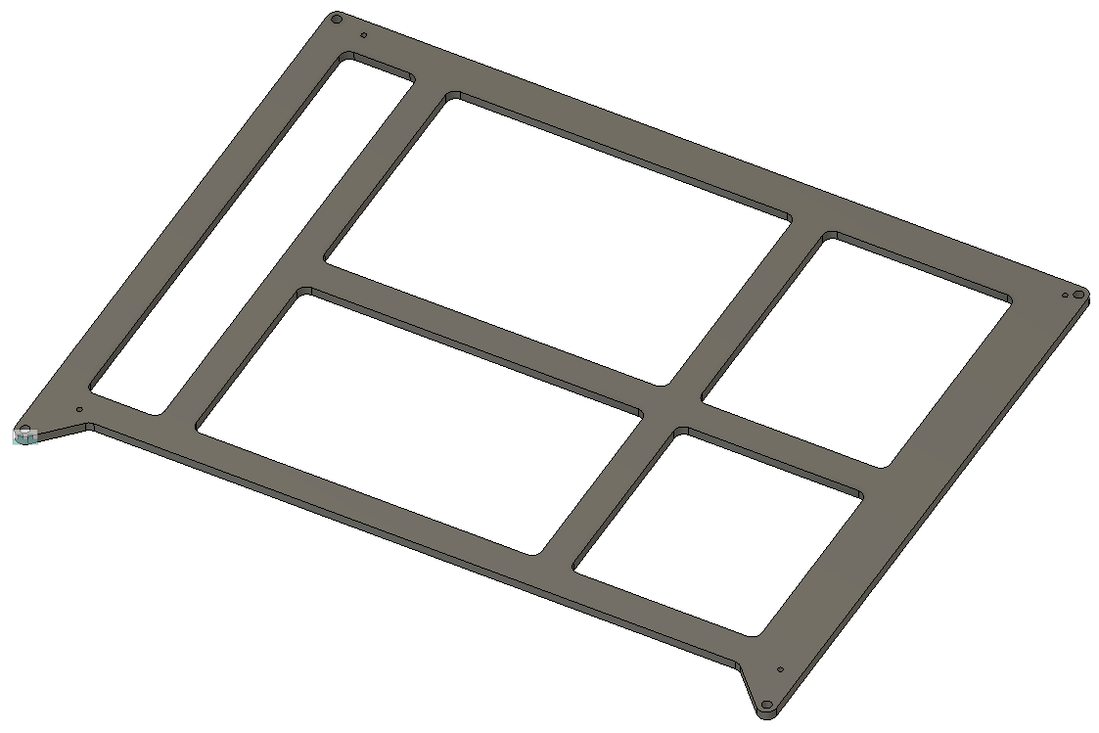
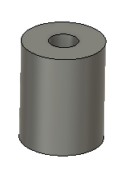
Component Overview
Bottom Case
eDP Cable Retainer
eDP Hinge Guide
Power Button
Power Button Spacer
KB-Mouse Interface Spacer
Display Panel Adapter
USB Hub Spacer (2x)

Slide 3
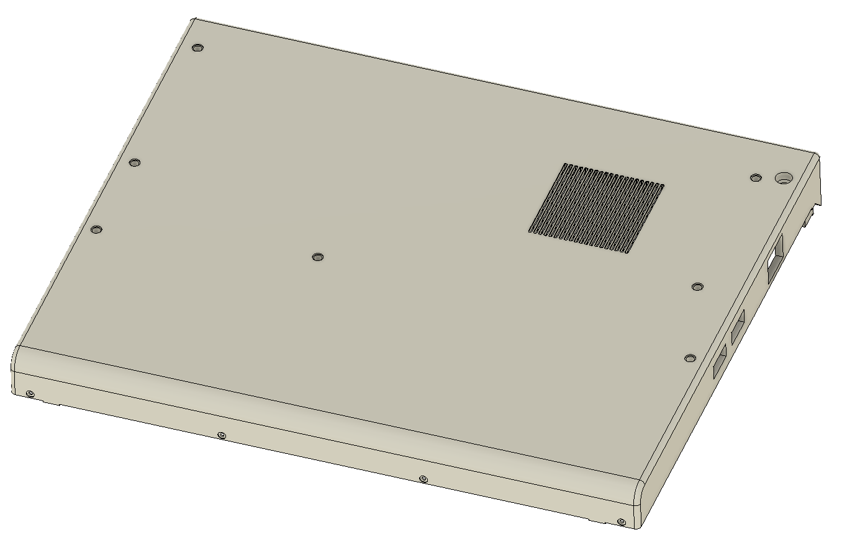
Bottom Case – Permanent Hardware
M2x0.4 heat-set insert
QTY 13
McMaster 94180A307
2.5mm x 20mm dowel
QTY 2
McMaster 91585A310

Slide 4
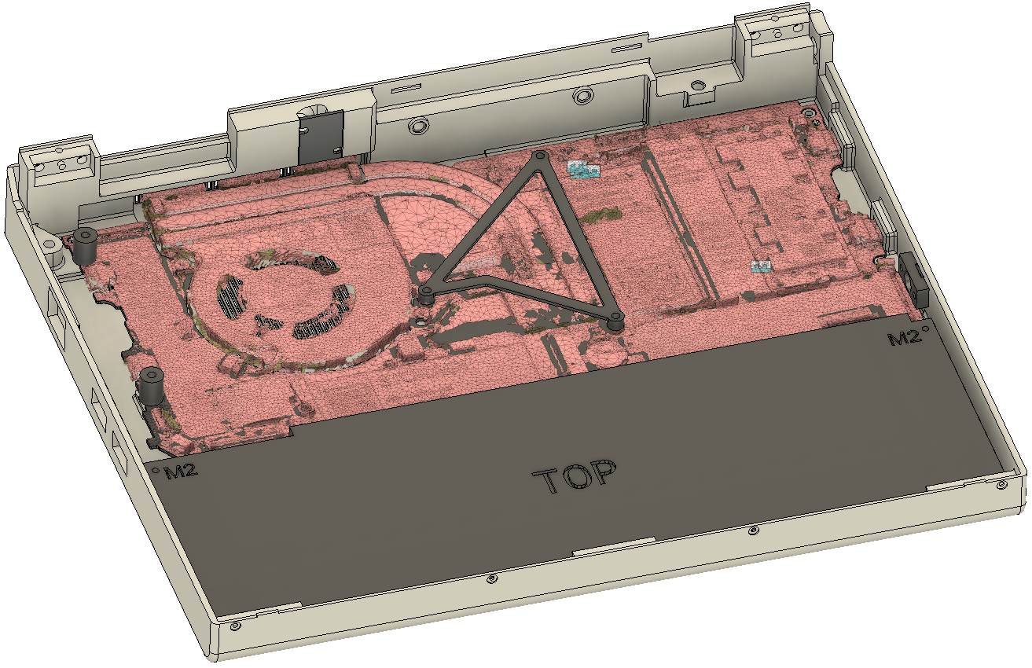
Bottom Case – Other Hardware
M3x25
Keyboard (top left) and top cover fastening (Installs from bottom)
QTY 1
McMaster 95836A536
M1xXX
Keyboard front edge
QTY 4
Original Thinkpad 701C
M2x5
Mainboard (3x), eDP retainer (2x), indicator board (2x)
QTY 7
McMaster 95836A107
M2x12
Battery
QTY 2
McMaster 95836A115
M2x8, low profile head
KB-Mouse interface board (replaces existing Framework fasteners)
QTY 3
McMaster 93070A277
M2x10, countersunk
Power Button
QTY 2
McMaster XXXXXXX
M2xXX
USB Hub and mainboard
QTY 2
McMaster XXXXXXX
M2xXX
Keyboard (top right)
QTY 1
McMaster XXXXXXX

